Slide 1
MEAN STACK PROJECT
BY:- DURGESH SHARMA CLASS: CS-2
ROLL NO. 0827CS181072

Slide 2


Slide 3
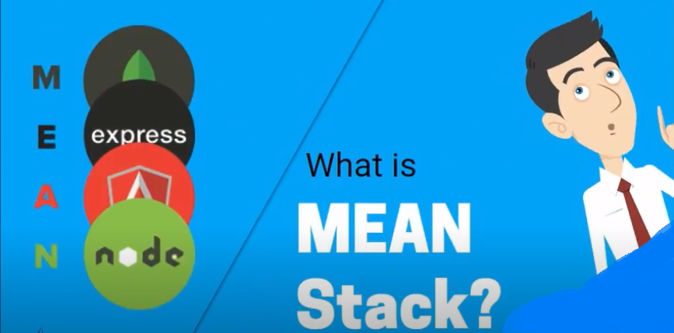

Slide 4
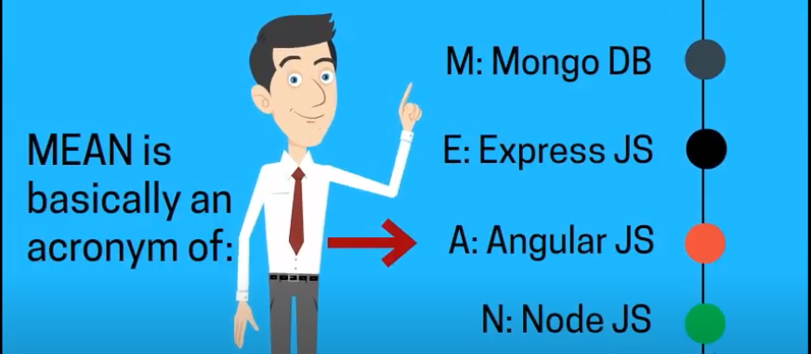

Slide 5
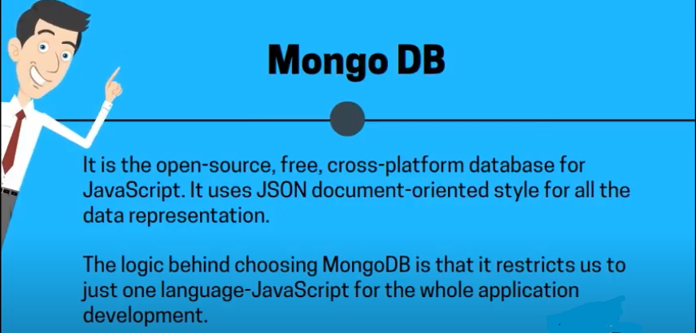

Slide 6
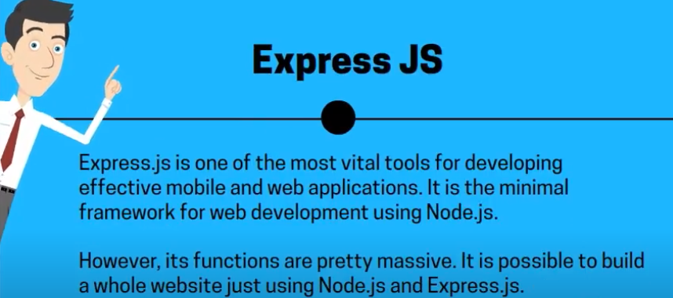

Slide 7
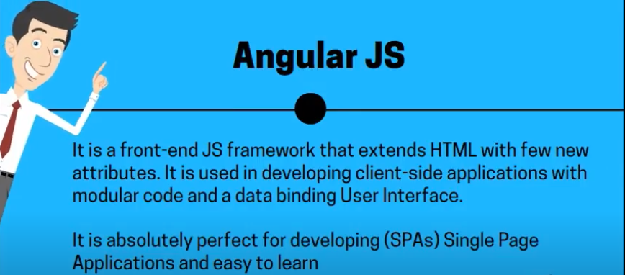

Slide 8
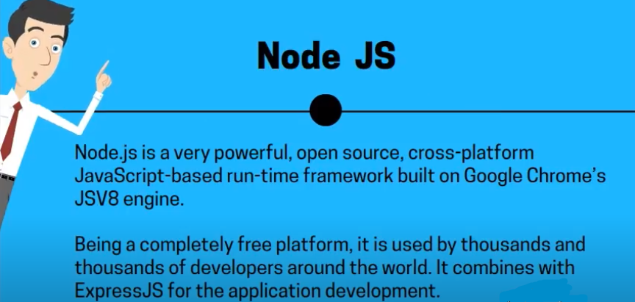

Slide 9
BENEFITS OF USING MEAN STACK FOR APPLICATION DEVELOPMENT

Slide 10
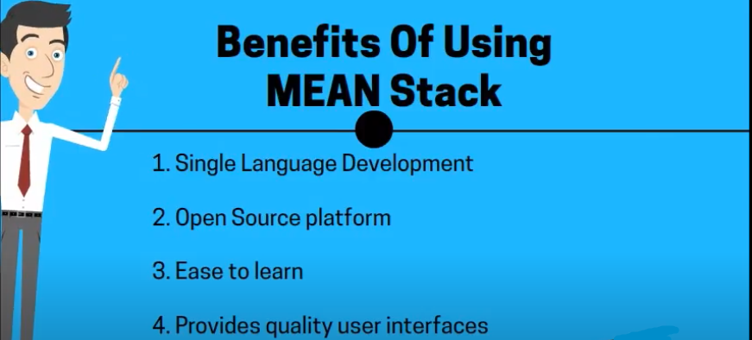

Slide 11
MY PROJECT:
RESPONSIVE USER LOGIN FORM

Slide 12
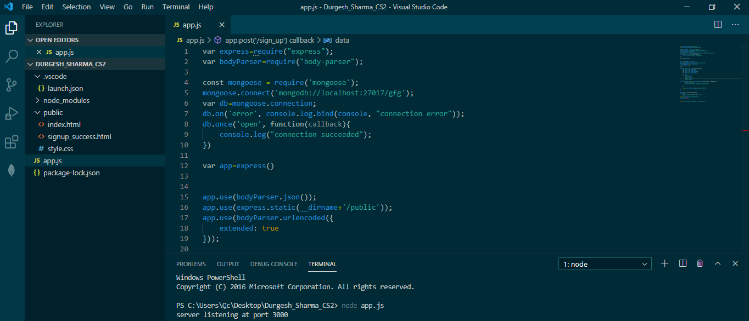

Slide 13
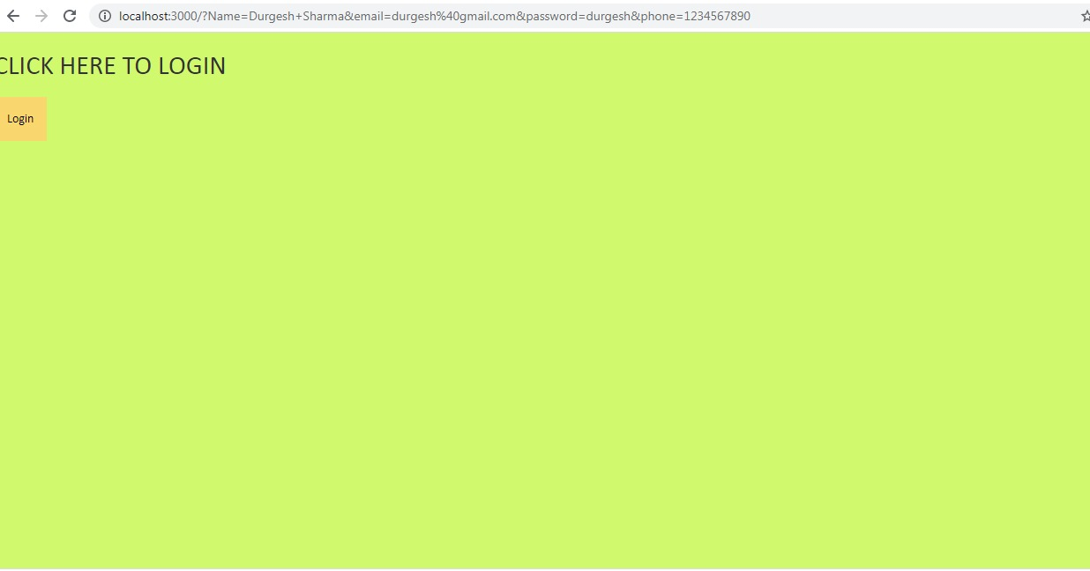

Slide 14
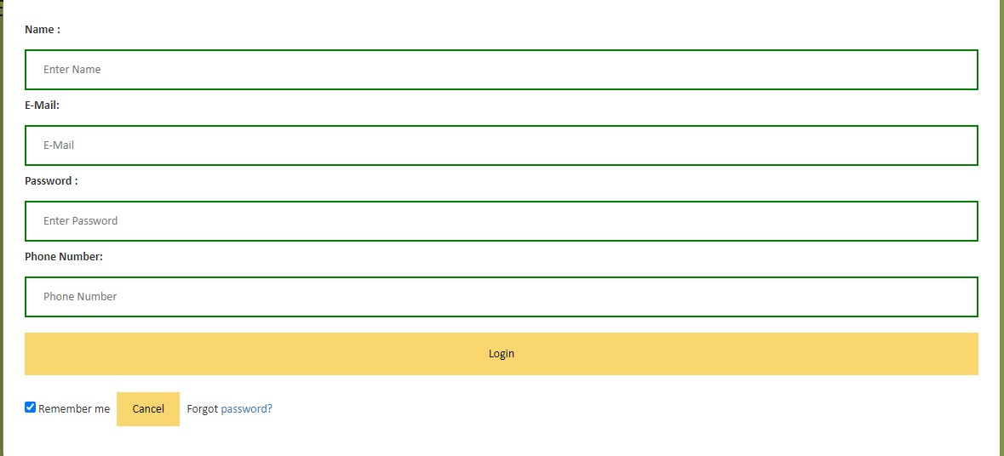

Slide 15
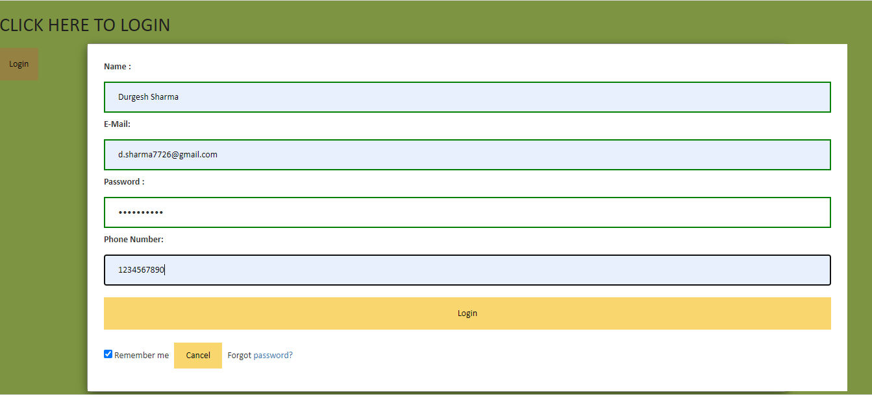

Slide 16
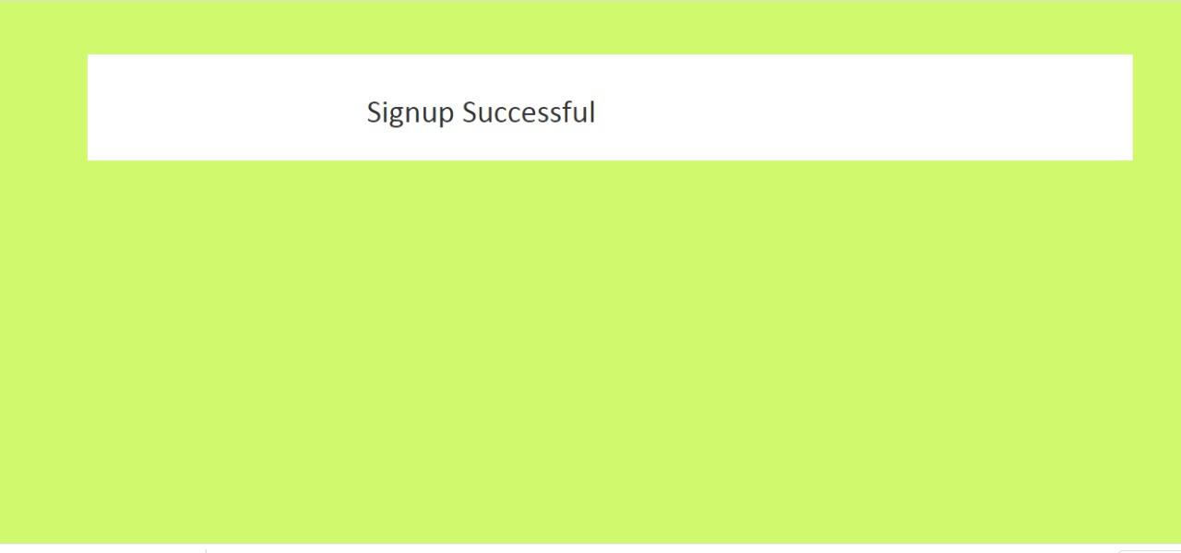

Slide 17
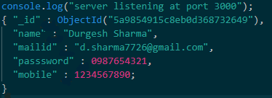
THE DATA HAS BEEN LOADED AND WE SEE THE OUTPUT THAT RESEMBLES THE FOLLOWING:
A NEW RECORD HAS BEEN CREATED.

Slide 18
THANK YOU

